Slide 1
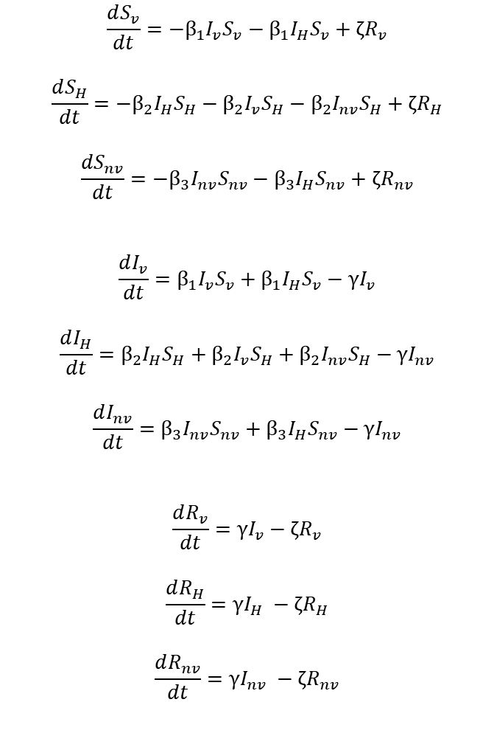
ζR_{v}
Model Equations
$$\frac{dS_{v}}{dt}=−β_{1}I_{v}S_{v}−β_{1}I_{H}S_{v}+ζR_{v}$$
$$\frac{dS_{H}}{dt}=−β_{2}I_{H}S_{H}−β_{2}I_{v}S_{H}−β_{2}I_{nv}S_{H}+ζR_{H}$$
$$\frac{dS_{nv}}{dt}=−β_{3}I_{nv}S_{nv}−β_{3}I_{H}S_{nv}+ζR_{nv}$$
$$\frac{dI_{v}}{dt}=β_{1}I_{v}S_{v}+β_{1}I_{H}S_{v}−γI_{v}$$
$$\frac{dI_{H}}{dt}=β_{2}I_{H}S_{H}+β_{2}I_{v}S_{H}+β_{2}I_{nv}S_{H}−γI_{nv}$$
$$\frac{dI_{nv}}{dt}=β_{3}I_{nv}S_{nv}+β_{3}I_{H}S_{nv}−γI_{nv}$$
$$\frac{dR_{v}}{dt}=γI_{v}−ζR_{v}$$
$$\frac{dR_{H}}{dt}=γI_{H} −ζR_{H}$$
$$\frac{dR_{nv}}{dt}=γI_{nv} −ζR_{nv}$$
“Shielded”
Population
S_{v}
β₁I_{v}S_{v}
I_{v}
γI_{v}
R_{v}
β₂I_{v}S_{H}
β₁I_{H}S_{v}
“Shielders”
Population
S_{H}
I_{H}
R_{H}
β₂I_{H}S_{H}
γI_{H}
ζR_{H}
β₃I_{H}S_{nv}
β₂I_{nv}S_{H}
“the rest”
Population
S_{nv}
I_{nv}
R_{nv}
β₃I_{nv}S_{nv}
γI_{nv}
Initial Conditions
Sv = 0.2
Sh = 0.1
Snv = 0.6999
Iv = 0
Ih = 0
Inv = 0.0001
Rv = 0
Rh = 0
Rnv = 0
ζR_{nv}
Beta1 = Reduction by 0.4 FOR 24 WEEKS (intervention in Vulnerable)
Beta2 = Reduction by 0.4 FOR 12 WEEKS (intervention in Shielded)
Beta3 = Reduction by 0.4 FOR 6 WEEKS (intervention in non-vulnerable)

Slide 2
Modelling Pre-Intervention Population Dynamics – No Mixing
Infectious pressure and the number of new infecteds is composed of beta, the fraction of susceptibles and the fraction of infecteds.
In a well mixed population, the vulnerable population is equally exposed to the entire infectious fraction (Ih and Inv)
However, upon segregating the population so that vulnerables can not contact the non-vulnerables – you have lose Fracnv of infectious contact.
This means that the infectious potential across the three populations will be unequal (compared to the shielded compartment which has access to100% of the infecteds).
As we want the infectious potential to be the same between all populations at baseline – we inflate certain population specific beta values to compensate for this loss in infectious potential when there is not a well mixed population
This is to accounts for the loss in infectious potential due to a decrease in exposure to a certain amount of the infectious fraction.
ζR_{V}
Vulnerable
Population
S_{V}
β₁I_{V}S_{V}
I_{V}
γI_{V}
R_{V}
β₄I_{R}S_{v}
β₁I_{V}S_{H}
β₁I_{H}S_{V}
Shielders
Population
S_{H}
β₂I_{H}S_{H}
I_{H}
R_{H}
γI_{H}
ζR_{H}
β₄I_{V}S_{R}
β₂I_{H}S_{R}
β₂I_{R}S_{H}
Remainder
Population
S_{R}
I_{R}
R_{R}
β₃I_{R}S_{R}
γI_{R}
ζR_{R}

Slide 3
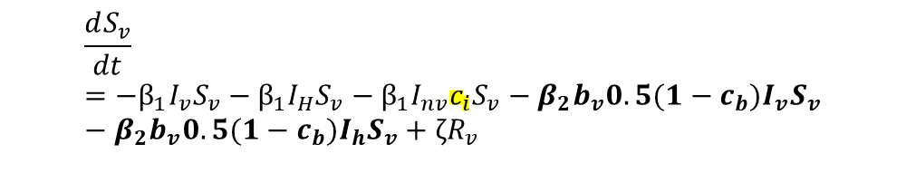

Modelling Pre-Intervention Population Dynamics – No Mixing
$$\frac{dS_{v}}{dt}=−β_{1}I_{v}S_{v}−β_{1}I_{H}S_{v}−β_{1}I_{nv}{c_{b}S}_{v}−β_{2}{b_{v}{0.5(1−c}_{b})I}_{v}S_{v}−β_{2}{b_{v}{0.5(1−c}_{b})I}_{h}S_{v}+ζR_{v}$$
This inflaton is carried over into the post intervention phase
This inflation is carried out
however in every scenario whether there any contact between the vulnerable and the non-vulnerable population – this transmission route is removed after the intervention is introduced.
$$\frac{dS_{v}}{dt}=−β_{1}I_{v}S_{v}−β_{1}I_{H}S_{v}−β_{1}I_{nv}{c_{i}S}_{v}−β_{2}{b_{v}{0.5(1−c}_{b})I}_{v}S_{v}−β_{2}{b_{v}{0.5(1−c}_{b})I}_{h}S_{v}+ζR_{v}$$

